Slide 1
Therapies
Chapter 15

Slide 2
Therapies
What is mental health therapy?
  Utah Law definition:
    “(a) conducting a professional evaluation of an individual's condition of mental health, mental illness, or emotional disorder consistent with standards generally recognized in the professions of mental health therapy
    (b) establishing a diagnosis in accordance with established written standards generally recognized in the professions of mental health therapy
    (c) prescribing a plan for the prevention or treatment of a condition of mental illness or emotional disorder; and
    (d) engaging in the conduct of professional intervention, including psychotherapy by the application of established methods and procedures generally recognized in the professions of mental health therapy”

Slide 3

Therapies
Media versions
http://youtu.be/BYLMTvxOaeE
http://youtu.be/XfmVBmDKLZI

Slide 4
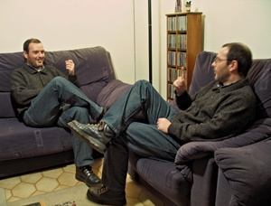
Therapies
Modalities
  Individual
  Couple
  Family
  Group
Settings
  Hospital
  Inpatient
  Residential
  Outpatient
  Wilderness

Slide 5
Therapies
Types
  Psychoanalytic therapy
    Memories
  Humanistic therapy
    Empathy
  Gestalt therapy
    Emotions
  Cognitive therapy
    Thoughts
  Behavioral therapy
    Actions
  Pharmacotherapy
    Psychotropics
Types
  Narrative therapy
    Stories
  Solution-focused therapy
    Successes
  Existential therapy
    Meanings
  Interpersonal therapy
    Relationships
  Medical therapy
    Surgery
  Experiential therapy
    Activities

Slide 6
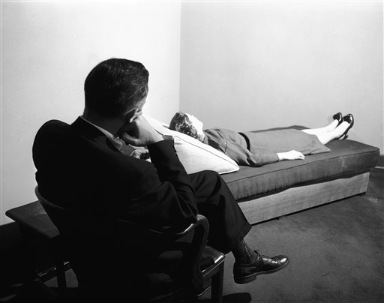
Therapies
Psychoanalytic
  Dream analysis
  Free association
  Analysis of resistance
  Analysis of transference

Slide 7
Therapies
Cognitive
  Ten Irrational Beliefs (page 519)
    Which do you hold?
    Talk and share with your neighbor
Behavior
  Operant conditioning
    Reinforcement
    Punishment
  Classical conditioning
    Aversion
    Desensitization
      Virtual reality exposure (http://youtu.be/a05JcckFZyg)

Slide 8
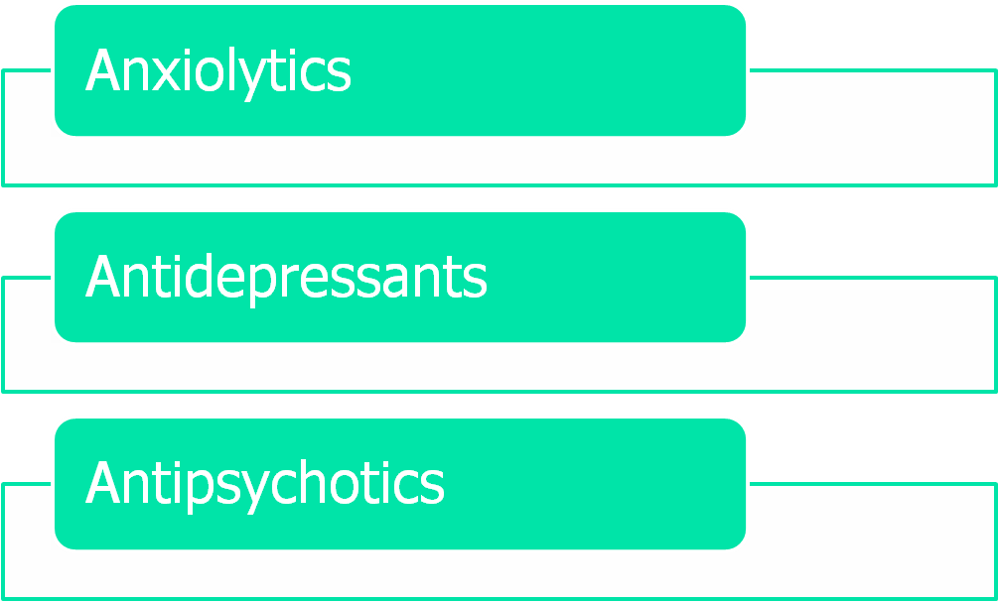
Therapies
Psychopharmacology

